Slide 1

Web Security Fundamentals
Presented by Boogeyman
A comprehensive guide to understanding web vulnerabilities, security testing tools, and essential security concepts for developers and security professionals.

Slide 2
Learning Roadmap
Web Foundations
Security Testing
Vulnerabilities
Client-server architecture, HTTP protocols, and how the web works at a fundamental level.
Burp Suite tools and techniques for discovering and analyzing web vulnerabilities.
Common attack vectors like SSRF and other exploitable security flaws in web applications.

Slide 3
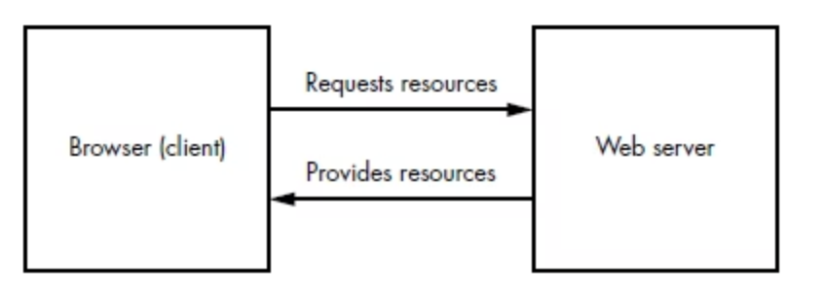
The Client-Server Model
Web communication follows a simple but critical architecture where clients (browsers) send requests to servers, which respond with data. Understanding this foundation is essential for identifying security weaknesses.
Programming Languages
Backend systems use Python, PHP, Node.js, Java, and many others to process requests.
HTTP Versions
HTTP/1.1, HTTP/2, and HTTP/3 each have different characteristics affecting performance and security.

Slide 4
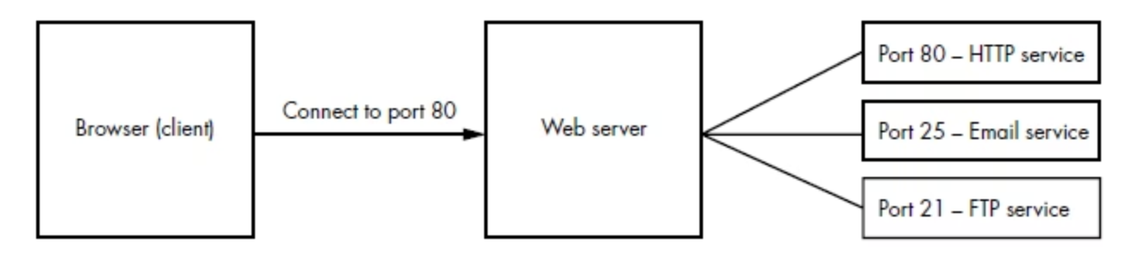
Internet Ports and Network Services
Ports are logical endpoints on a server that identify specific services. Common ports include 80 (HTTP), 443 (HTTPS), 22 (SSH), and 3306 (MySQL). Understanding port mapping helps identify exposed services and potential attack surfaces during reconnaissance.

Slide 5
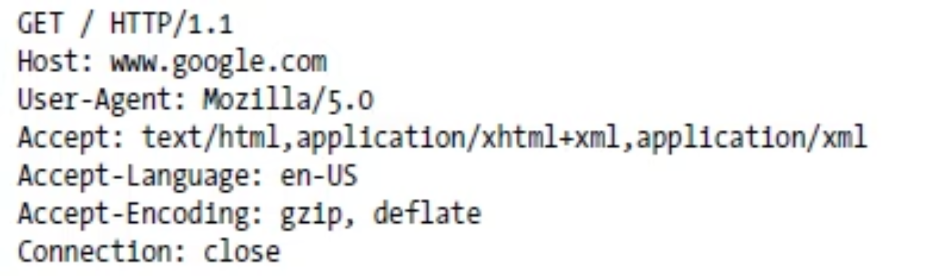
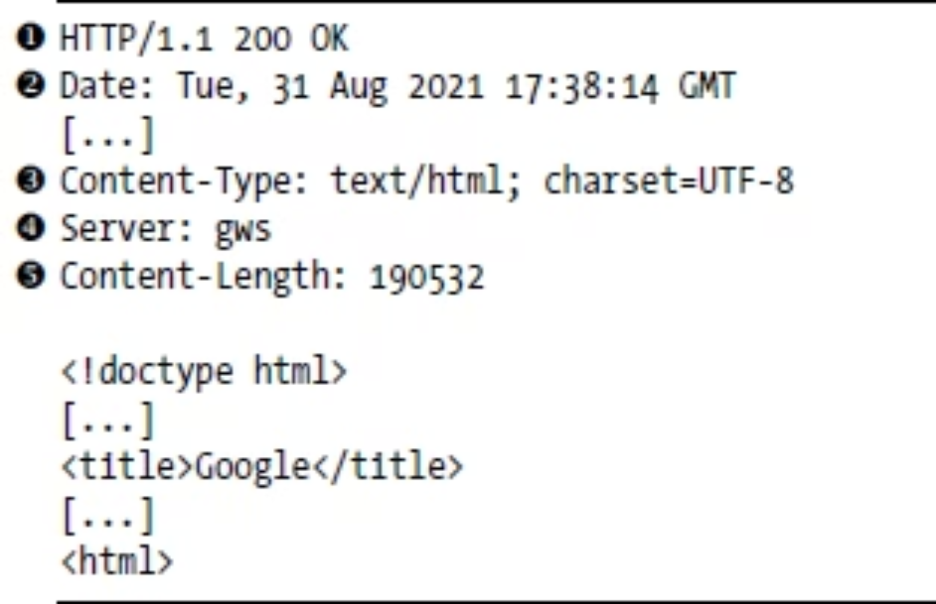
HTTP Requests and Responses
HTTP is the protocol that powers the web. Every interaction between client and server follows a request-response cycle. Requests contain methods (GET, POST, etc.), headers, and optional bodies, while responses include status codes and content.

Slide 6
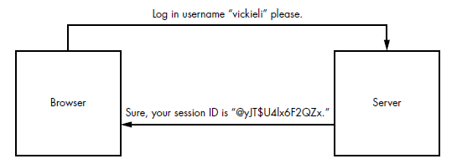
Session Management and HTTP Cookies
HTTP is stateless—each request is independent. Servers use cookies to maintain session state, storing user information like authentication tokens. Understanding cookie mechanics is critical for identifying session hijacking and other session-based vulnerabilities.

Slide 7
Scope Discovery and Reconnaissance
Before testing for vulnerabilities, security professionals must map the target application's attack surface through systematic enumeration.
01
02
03
Subdomain Enumeration
Service Enumeration
Directory Brute-Forcing
Use gobuster dns to discover subdomains. Command: gobuster dns -d target_domain -w wordlist. Layer deeper by brute-forcing subdomains of subdomains.
Deploy nmap to identify open ports and running services on the target infrastructure.
nmap
Use gobuster dir to discover hidden directories. Command: gobuster dir -u target_url -w wordlist

Slide 8

Setting Up Your Security Testing Proxy
A proxy intercepts traffic between your browser and web servers, allowing you to inspect, modify, and replay requests—essential for security testing.
Browser ↔ Proxy ↔ Server
The proxy sits in the middle of the communication, capturing all traffic so you can verify both frontend and backend behavior, modify payloads, and test security boundaries without relying on source code access.

Slide 9

Burp Suite: Your Security Testing Arsenal
Community vs. Professional
Community Edition is free and includes core features. Professional Edition adds automated scanning, advanced tools, and 24/7 support.
Essential Tools
Repeater: Manually craft and send requests
Intruder: Automate attacks with payload variations
Decoder: Encode/decode data formats
And more: Scanner, Comparer, Collaborator

Slide 10
Authentication
Burpsuite
Intruder
Hydra
hydra -l jeremy -P /usr/share/wordlists/rockyou.txt 127.0.0.1 http-post-form \
"/labs/a0x01.php:username=^USER^&password=^PASS^:F=Your username or password was incorrect" \
-t 16 -o hydra-found.txt
Labs

Slide 11
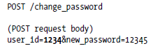
INSECURE DIRECT OBJECT REFERENCES (IDOR)
IDORs happen when users can access resources that do not belong to them by directly referencing the object ID, object number, or filename.
https://example.com/messages?user_id=1234.

Slide 12
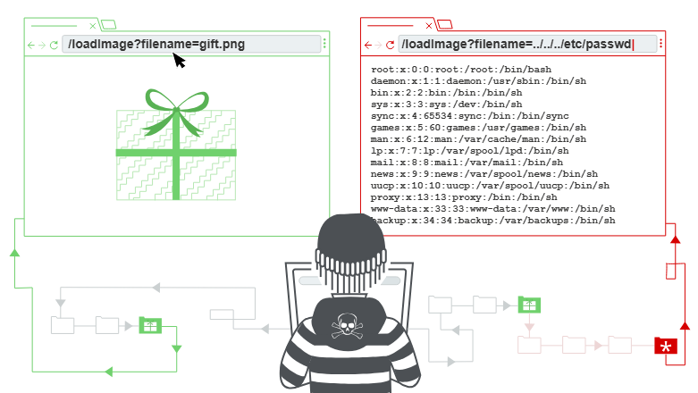
Path traversal & LFI & RFI
From LFI or RFI to RCE

Slide 14
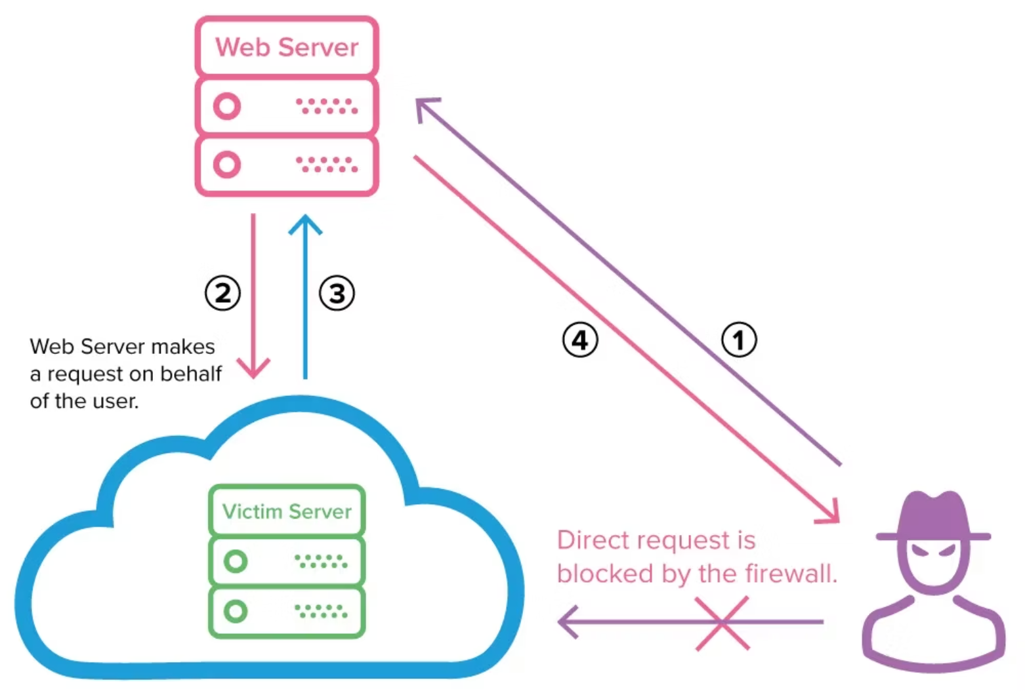
Server-Side Request Forgery (SSRF)
SSRF occurs when a web application makes requests to external URLs without proper validation. An attacker can manipulate the URL parameter to access internal services, bypassing network security controls.
Vulnerable Example
A feed aggregator might use:
https://example.com/feed.php?url=externalsite.com/feed
An attacker changes the url parameter to localhost or internal IPs, accessing resources meant to be private.
Mitigation: Validate and whitelist allowed URLs, block internal IP ranges, disable unnecessary protocols, and implement network segmentation.

Slide 15
RCE
Labs

